Slide 1
An introduction to Pandas
Francesca van Tartwijk
LAG-MNG Python lecture
26 May 2020

Slide 2
Overview
The model system
The model
The Pandas DataFrame
Manipulating DataFrames
Pandas for data visualisation

Slide 3
The model system

Slide 4
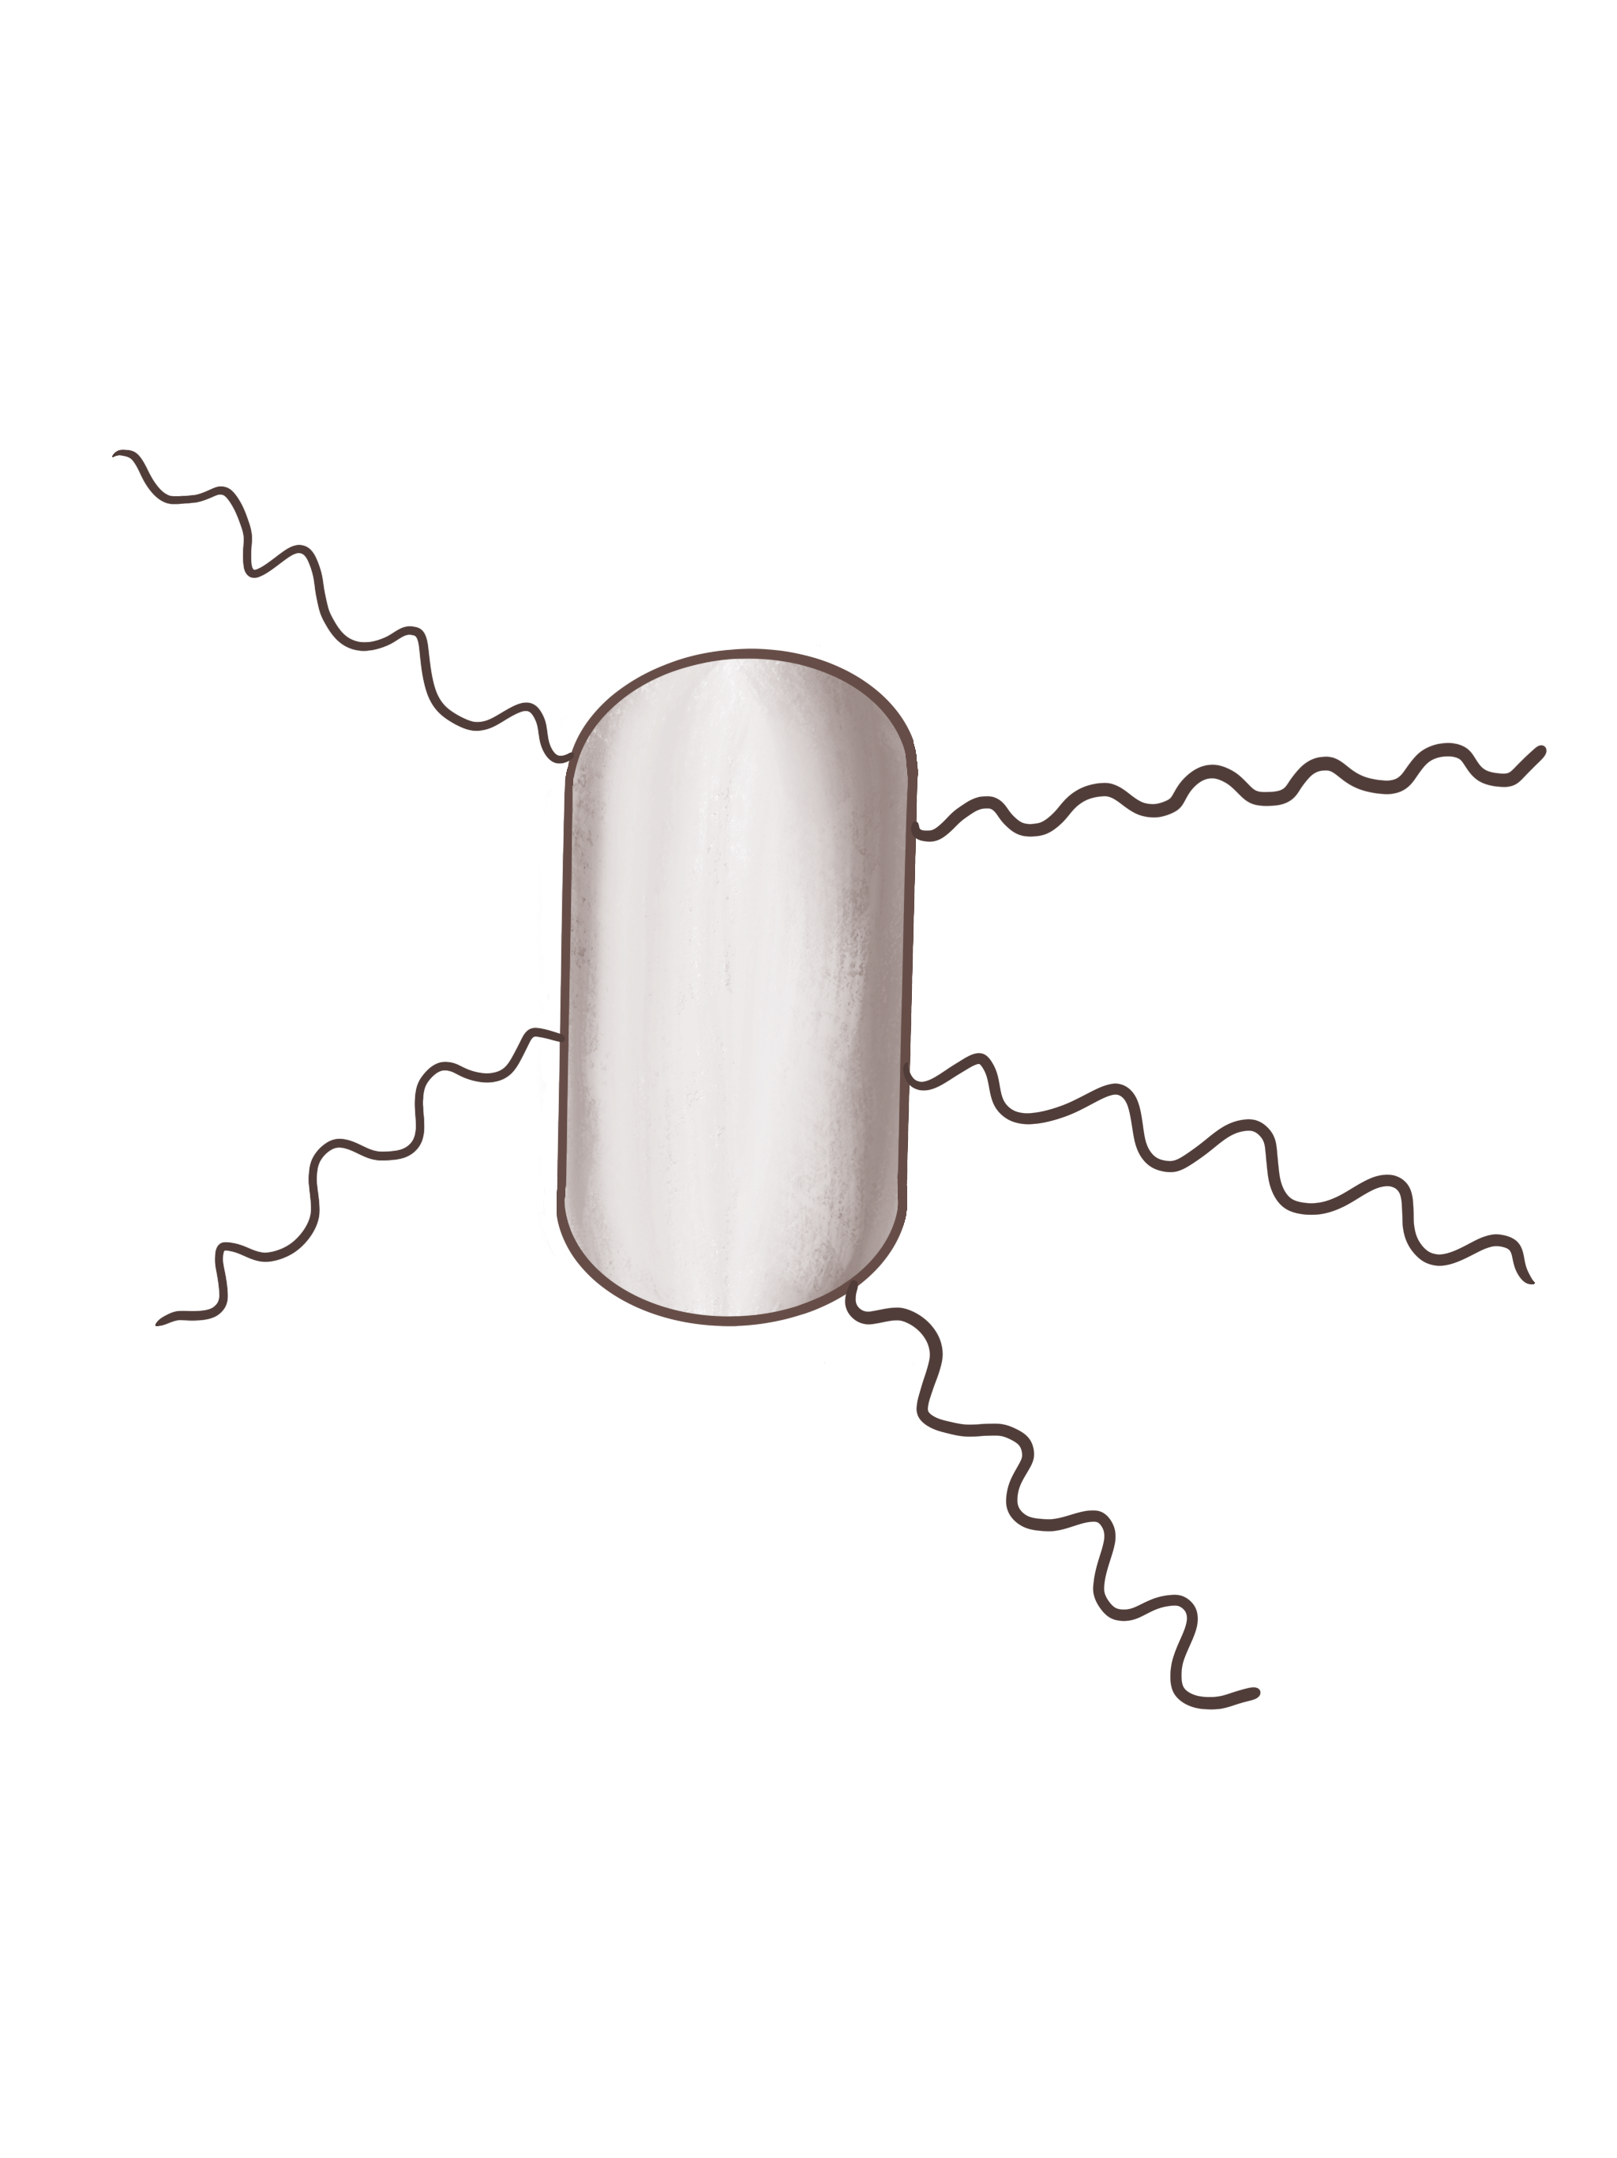

E. coli movement is a random walk
E. coli is propelled forward by several flagella (filaments attached to the cell)
When the flagella are bundled, the cell moves (a ‘run’). When they disperse, the cell halts. It then reorients randomly due to Brownian motion (a ‘tumble’).
A tumbling cell (rotational but no translational motion)
A running cell (translational but no rotational motion)

Slide 5
Presence of an attractant suppresses tumbling, resulting in biased random walks
Uniform attractant distribution – no net displacement
Attractant gradient – biased random walk

Slide 6
The model

Slide 7
The output: biased random tracks

Slide 8
To the Notebook! Quick look at the model

Slide 9
The Pandas DataFrame

Slide 10
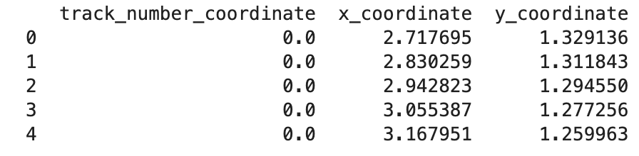
A DataFrame is a table-like structure
A column header
A row index
A column

Slide 11
Values can be accessed using headers and indices
df[2:4]
df.loc[2:3, [’x_coordinate’, ‘y_coordinate’]
df[‘x_coordinate’]

Slide 12
A note on types and syntax
The object that Pandas works with (the ‘table’) is called a DataFrame, which is a class object
You can’t simply call a function on an instance object (a particular DataFrame)
Instead, you call a method, which is effectively a function that ‘belongs’ to the object (this is an attribute reference).
The syntax in Python is: object.method
The method is usually called right after it is bound: object.method()

Slide 13
To the Notebook! Handy methods you can apply to DataFrames

Slide 14
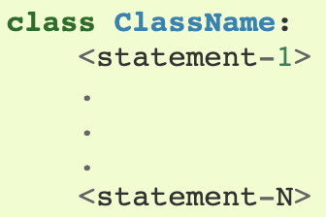
DataFrames: the idea of ‘class’
So far, we have mainly encountered immutable basic types and mutable objects like lists
Pandas works with DataFrames, which are ‘class objects’
A class definition looks like this:

Slide 15
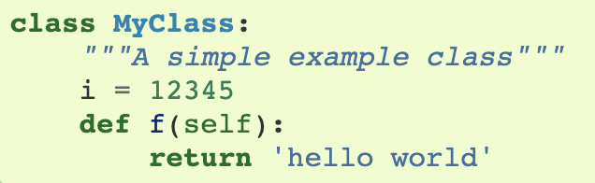
DataFrames: attribute references
Class objects support attribute references and instantiation
Consider this example of a class instance (comes into existence when class definition is called):
You can call myClass.f to access the function object: an attribute reference

Slide 16

DataFrames: instance objects
Class instantation uses function notation: you can pretend the class object is a parameterless function that returns a new instance of the class
The only operations you can perform on instance objects are attribute references. These include methods.

Slide 17
Methods and method objects
Say an example class instance x of MyClass is created
x.f is a method object
A method is usually called right after is is bound: x.f()
The object is passed as the first argument of the function.

